Slide 1

Sequence Models
Sequence models are powerful tools for processing sequential data, such as text, speech, and time series. They capture the relationships between elements in a sequence and predict future values.
N

Slide 2
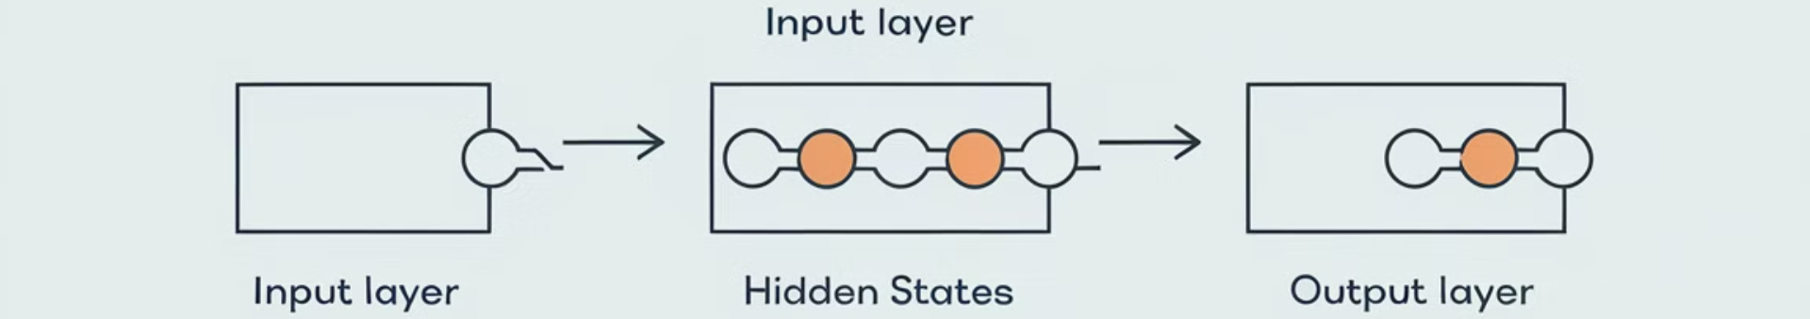
Introduction to Sequence Models
Sequence models are used to analyze and predict sequences of data, such as text, speech, or time series. They learn from past patterns in the data and generate meaningful insights.
1
Analyzing Patterns
2
Generating Outputs
3
Wide Range of Applications
They discover temporal relationships between elements in a sequence, allowing for the understanding of trends and dependencies.
They can predict future values, complete missing sequences, or generate entirely new sequences based on learned patterns.
Their applications extend to natural language processing, speech recognition, machine translation, and many other areas.

Slide 3
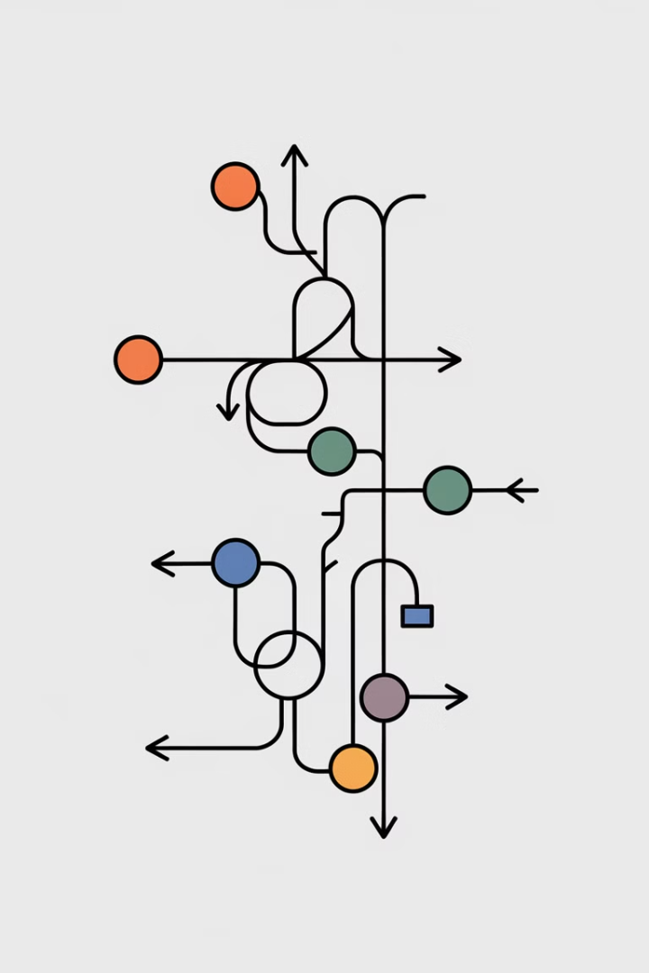
Recurrent Neural Networks (RNNs)
RNNs are a type of neural network specifically designed to handle sequential data.
1
Input Sequence
The input sequence is processed one element at a time.
2
Hidden State
The hidden state maintains information from previous time steps, enabling the network to remember past context.
3
Output Sequence
The network generates an output sequence based on the learned relationships between the input and hidden states.

Slide 4
Long Short-Term Memory (LSTMs)
LSTMs address the vanishing gradient problem in RNNs, allowing them to learn long-term dependencies in sequences.
Forget Gate
Input Gate
Output Gate
Decides which information to discard from the previous hidden state.
Determines which part of the current input to store in the memory cell.
Controls the amount of information from the memory cell that is passed to the next hidden state.

Slide 5
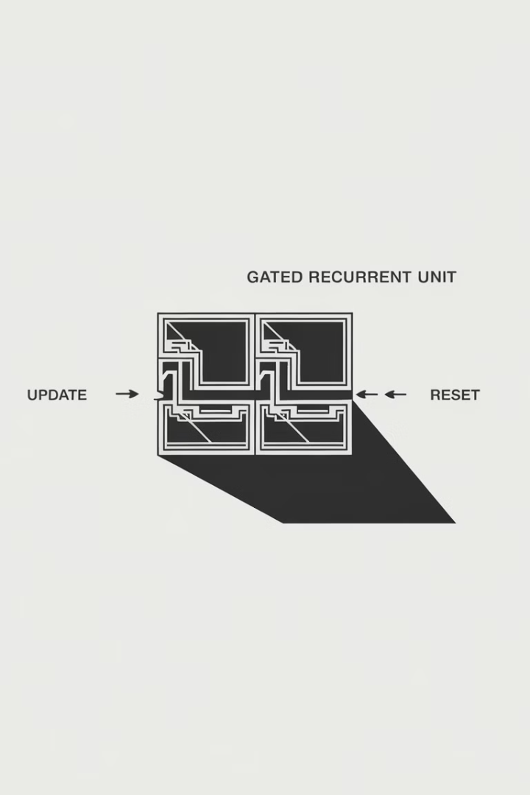



Gated Recurrent Units (GRUs)
GRUs are a simplified version of LSTMs, with fewer gates, making them more efficient to train.
Update Gate
Controls how much information from the previous hidden state is passed to the current hidden state.
Reset Gate
Determines how much of the previous hidden state is reset.
Candidate Hidden State
A new hidden state is calculated based on the current input and the reset hidden state.

Slide 6
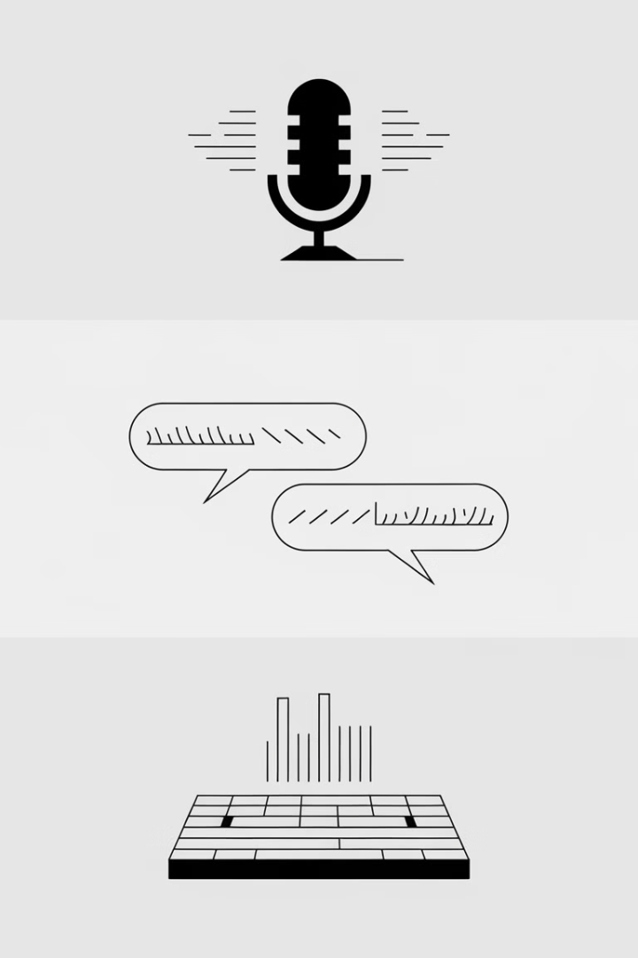
Applications of Sequence Models
Sequence models have revolutionized various domains by providing efficient solutions for tasks involving sequential data.
Natural Language Processing
Speech Recognition
Automatic speech recognition, voice assistants, speech-to-text conversion.
Language modeling, machine translation, sentiment analysis, question answering.
Time Series Analysis
Stock market prediction, weather forecasting, anomaly detection, trend analysis.

Slide 7

Challenges and Limitations
Despite their success, sequence models face challenges that limit their performance and applicability.
Data Dependency
Performance heavily relies on the quality and quantity of training data.
Vanishing Gradients
Difficulty in learning long-term dependencies due to the vanishing gradients problem.
Computational Complexity
Training and inference can be computationally expensive, requiring significant resources.

Slide 8




Future Trends in Sequence Modeling
Research continues to push the boundaries of sequence modeling, with new advancements on the horizon.
Attention Mechanisms
Allow models to focus on specific parts of the input sequence, improving performance and interpretability.
Transformers
A powerful architecture that has achieved state-of-the-art results in various NLP tasks.
Generative Models
Enable the generation of new sequences based on learned patterns, with applications in creative writing, music composition, and more.

Slide 9

Text Preprocessing in Deep Learning
Text preprocessing is a crucial step in deep learning for natural language processing (NLP). It transforms raw text data into a format that deep learning models can effectively process and learn from.
DN

Slide 10

Importance of Text Preprocessing
1
Reduces Noise
2
Enhances Consistency
Text preprocessing removes irrelevant characters and symbols, improving model accuracy and efficiency.
Transforms text into a uniform format, allowing models to effectively compare and analyze data.
3
Improves Performance
Preprocessing helps models focus on relevant features, reducing training time and improving results.

Slide 11
Tokenization
Word Tokenization
Character Tokenization
Subword Tokenization
Splits text into individual words, creating a list of tokens. Each word is treated as a separate unit.
Breaks text into individual characters, creating a list of tokens. This method is useful for languages without spaces between words.
Splits text into smaller units than words, such as morphemes or syllables, providing more nuanced information.

Slide 12
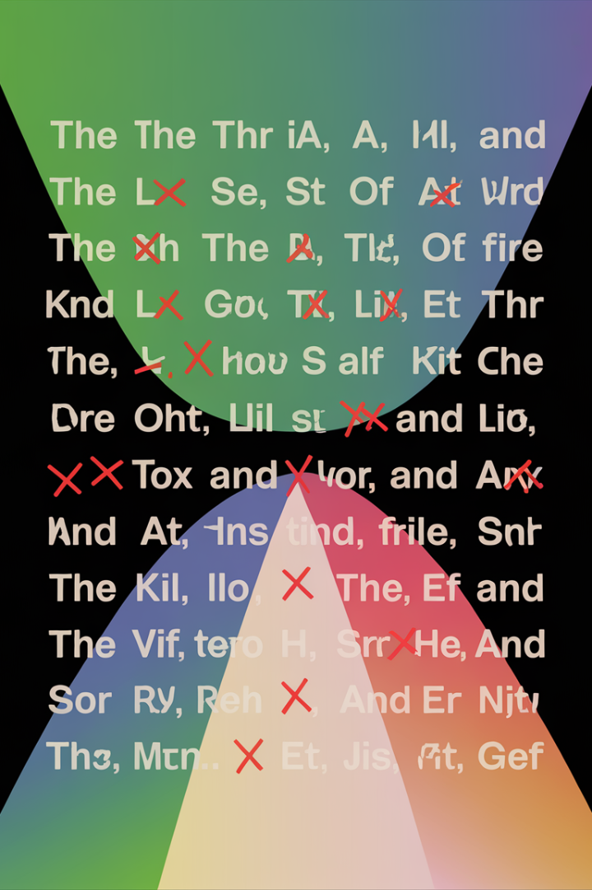
Stop Word Removal
Stop words
Common words
Little meaning
Examples
the, a, an, is, are, was
Not important for analysis

Slide 13
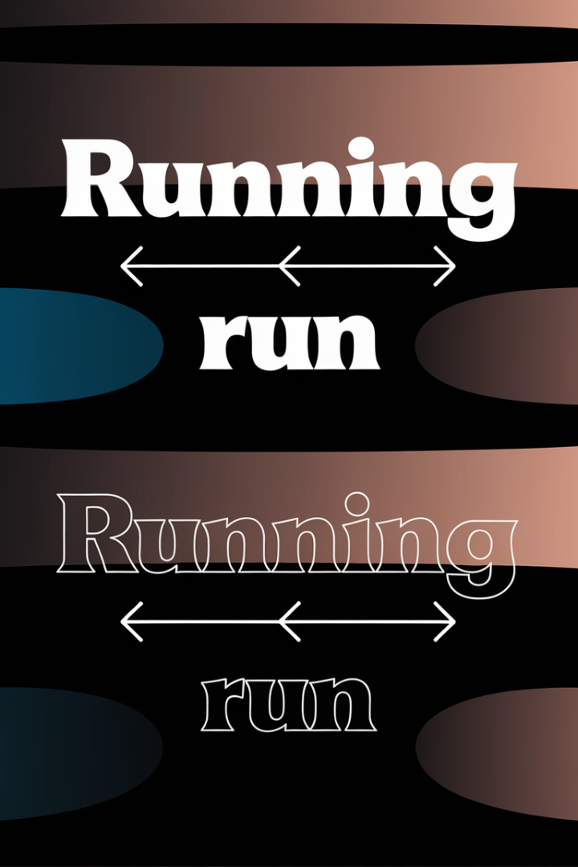


Lemmatization and Stemming
Lemmatization
Reduces words to their dictionary form, considering context and grammar.
Stemming
Removes suffixes from words, resulting in a simpler root form.

Slide 14
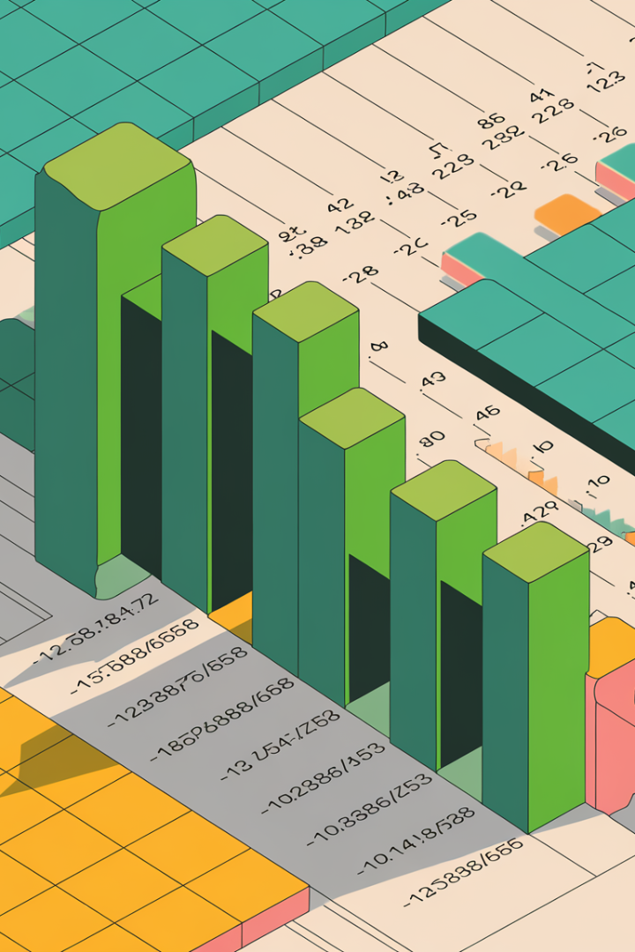
Handling Numerical Data
Conversion
Normalization
Transform numerical data into text, making it suitable for text preprocessing techniques.
Standardize numerical values, ensuring consistent data representation and improving model performance.
Categorization
Group numerical data into meaningful categories, simplifying analysis and improving model interpretability.

Slide 15
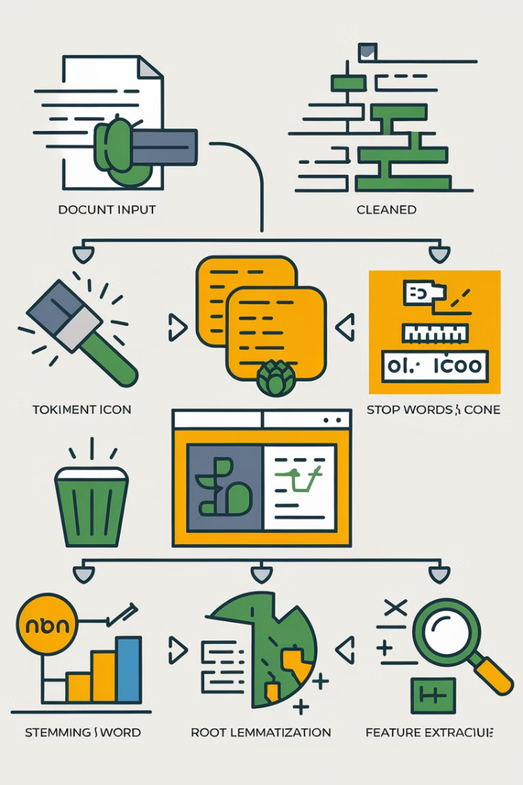



Feature Engineering
N-grams
Extract sequences of words, capturing the relationships between words.
Part-of-Speech Tagging
Identify the grammatical function of each word, providing structural information.
Named Entity Recognition
Identify and classify named entities, such as people, places, and organizations.

Slide 16
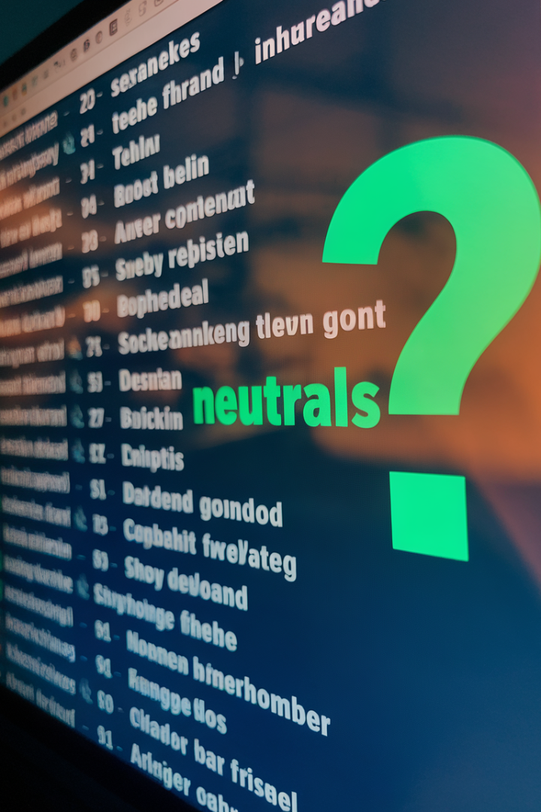
Handling Out-of-Vocabulary Words
1
Unknown Words
Words not present in the model's vocabulary are treated as out-of-vocabulary words.
2
Replacement
Replace unknown words with special tokens, preserving information for further processing.
3
Subword Representation
Break down unknown words into smaller units, allowing the model to partially recognize and process them.

Slide 17

Conclusion and Next Steps
Text preprocessing is essential for success in deep learning for NLP. It prepares data for accurate analysis and improves model performance.

Slide 18

Language Models and Datasets
Language models are sophisticated algorithms capable of understanding and generating human language. They're trained on massive datasets, enabling them to learn complex linguistic patterns.
DN

Slide 19

Introduction to Language Models
Language models are a type of artificial intelligence that focuses on understanding and generating text.
1
Statistical Analysis
2
Predicting Words
They leverage statistical analysis to learn patterns and relationships within vast amounts of text data.
Language models are designed to predict the next word in a sequence based on the preceding words.
3
Contextual Understanding
They learn to understand the context of words and phrases, enabling them to generate coherent and meaningful text.

Slide 20
Types of Language Models
Language models are categorized based on their architectures and the specific tasks they're designed to perform.
Recurrent Neural Networks (RNNs)
Long Short-Term Memory (LSTM)
Transformers
Transformers have become increasingly popular due to their ability to capture complex relationships between words and phrases, leading to significant advancements in natural language processing tasks.
RNNs are well-suited for processing sequential data, such as text, by considering the order of words.
LSTMs are a variant of RNNs that excel at handling long-range dependencies in text, making them effective for tasks like machine translation.

Slide 21

Datasets for Training Language Models
Training a language model requires massive amounts of text data to learn the nuances of language.
Common Crawl
Wikipedia
A massive dataset of web pages, providing a broad overview of language used on the internet.
The vast collection of articles from Wikipedia serves as a rich source of well-structured and informative text.
BooksCorpus
A collection of digitized books, providing a diverse range of literary styles and genres.

Slide 22

Data Preprocessing for Language Models
Data preprocessing is crucial for preparing datasets for language model training.
Tokenization
Cleaning
Breaking down text into individual units, such as words or subwords, for processing by the model.
Removing irrelevant characters, punctuation, or special symbols from the text.
1
2
3
Lowercasing
Converting all text to lowercase to ensure consistency and reduce the number of unique words.

Slide 23




Challenges in Language Model Training
Training language models presents several challenges.
Data Quality
Ensuring the quality and relevance of training data is critical for model performance.
Overfitting
Models can overfit to training data, leading to poor generalization on unseen data.
Computational Resources
Training large language models requires significant computational resources, such as GPUs and specialized hardware.

Slide 24
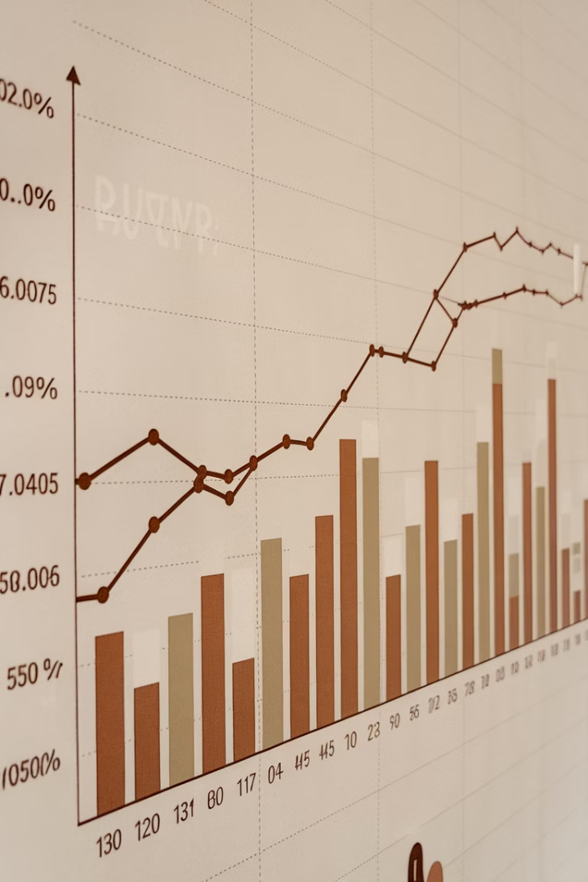
Model Evaluation and Metrics
Evaluating language model performance requires appropriate metrics.
Metric
Description
Perplexity
Measures how well a model predicts the next word in a sequence.
BLEU Score
Evaluates the quality of machine translation by comparing generated text to human translations.

Slide 25





Applications of Language Models
Language models have a wide range of applications in various domains.
Chatbots
Machine Translation
Language models power conversational AI agents, providing natural and engaging interactions.
They enable accurate and fluent translation of text between different languages.
Text Summarization
Code Generation
Language models can automatically generate concise summaries of lengthy texts.
They're being used to assist in writing and debugging code, particularly in areas like natural language processing.

Slide 26

Conclusion and Future Trends
Language models have revolutionized natural language processing, and their capabilities continue to evolve.
1
Multimodality
2
Personalized Experiences
Integrating language models with other modalities, such as images and audio, will lead to more sophisticated and human-like AI systems.
Language models will personalize user experiences, tailoring content and interactions based on individual preferences and needs.
3
Ethical Considerations
As language models become increasingly powerful, ethical considerations regarding bias, fairness, and responsible use will become paramount.

Slide 27
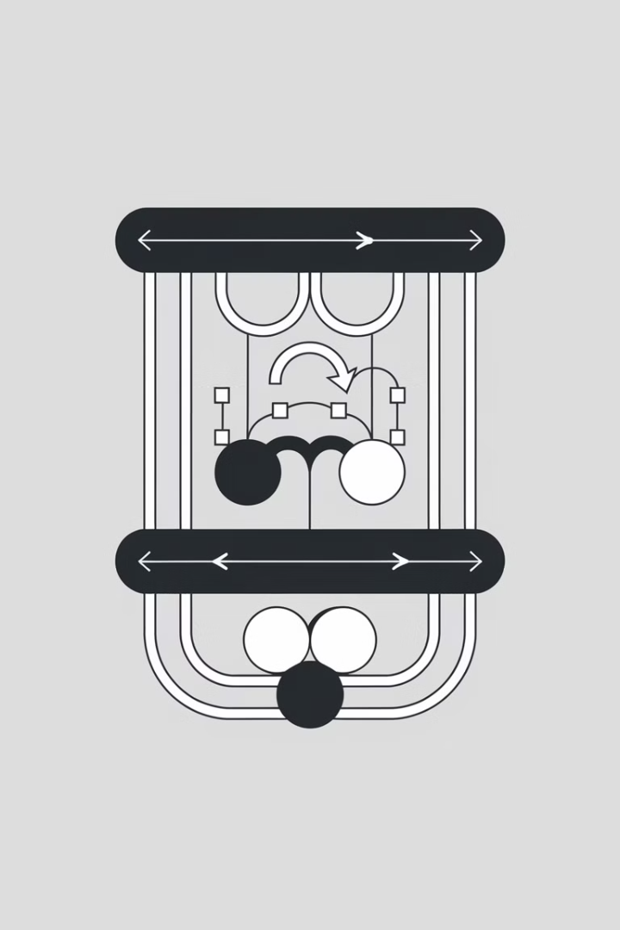
Recurrent Neural Networks (RNNs)
Recurrent Neural Networks (RNNs) are a type of artificial neural network specifically designed to process sequential data, such as text, audio, or time series data.
DN

Slide 28
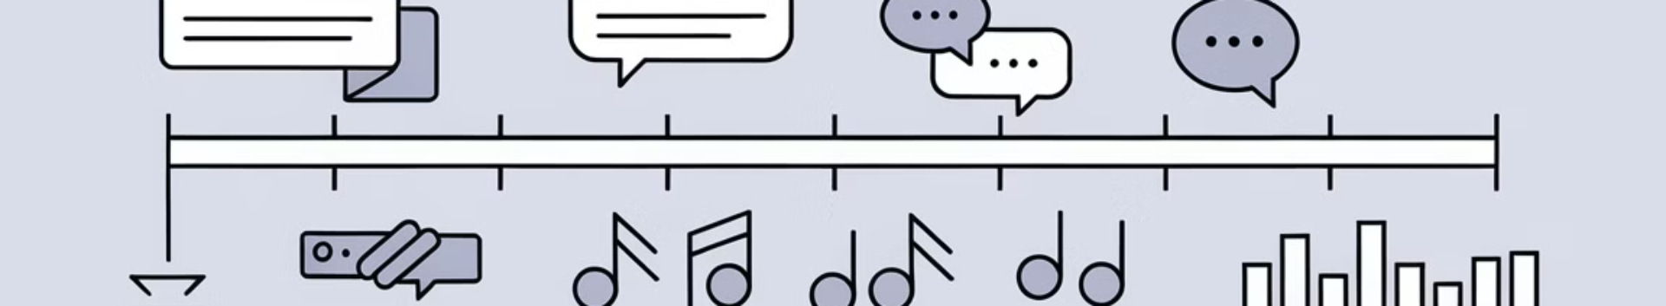
Sequential Data and Sequence Modeling
Sequence modeling is a crucial aspect of artificial intelligence, allowing machines to understand and predict patterns within sequences of data.
1
Text Sequences
2
Audio Sequences
3
Time Series Data
RNNs can learn the relationships between words in a sentence or document, enabling tasks like language translation and text generation.
RNNs excel at processing speech and audio data, making them valuable for tasks like speech recognition and music generation.
RNNs can model trends and patterns in time series data, aiding in tasks like stock market prediction and weather forecasting.

Slide 29
The Concept of Memory in RNNs
Unlike traditional feedforward neural networks, RNNs possess an internal memory mechanism that allows them to learn and remember information from previous inputs in a sequence.
Short-Term Memory
Long-Term Memory
RNNs store information about recent inputs, enabling them to capture dependencies between consecutive data points.
RNNs can retain information over extended periods, making them capable of learning relationships between distant inputs in a sequence.

Slide 30




RNN Architecture and Unrolling
The core of an RNN is a recurrent cell that takes an input, processes it, and updates its internal state. This state is then used as input for the next time step, creating a feedback loop.
Input
At each time step, the RNN receives an input, such as a word in a sentence or a value in a time series.
Hidden State
The recurrent cell processes the input and updates its internal state, which represents the memory of the network.
Output
The RNN produces an output based on the current input and its internal state, potentially predicting the next element in the sequence.

Slide 31

Backpropagation Through Time (BPTT)
BPTT is a key algorithm used to train RNNs. It allows the network to learn by propagating the error signal backward through time, adjusting the weights of the recurrent cell at each time step.
1
Forward Pass
The input sequence is fed through the network, updating the internal state and generating an output at each time step.
2
Error Calculation
The difference between the predicted output and the actual target is calculated at each time step, forming the error signal.
3
Backward Pass
The error signal is propagated backward through time, adjusting the weights of the network at each time step to minimize the error.

Slide 32

Challenges in Training RNNs: Vanishing and Exploding Gradients
Training RNNs can be challenging due to the vanishing and exploding gradient problems, which arise from the long-term dependencies learned by the network.
Vanishing Gradients
Gradients become extremely small as they propagate through time, preventing the network from learning long-term dependencies.
Exploding Gradients
Gradients become extremely large, causing instability in the training process and leading to poor performance.

Slide 33



Addressing Challenges: LSTM and GRU
LSTM (Long Short-Term Memory) and GRU (Gated Recurrent Unit) are specialized RNN architectures designed to overcome the vanishing and exploding gradient problems.
Gates
Memory Control
LSTM and GRU cells use gates to control the flow of information through the network, enabling them to learn long-term dependencies more effectively.
These gates allow the cells to selectively store or forget information, preventing the vanishing or exploding of gradients during training.

Slide 34

Applications of RNNs: Language Modeling, Machine Translation, and Speech Recognition
RNNs have found extensive applications across various domains, revolutionizing natural language processing, speech processing, and other areas.
Language Modeling
Machine Translation
RNNs are used to predict the probability of the next word in a sequence, enabling tasks like text generation, auto-completion, and grammar correction.
RNNs can learn the relationships between words in different languages, enabling automatic translation between languages with high accuracy.
Speech Recognition
RNNs are used to transcribe speech into text, enabling tasks like voice assistants, dictation software, and speech-to-text conversion.

Slide 35
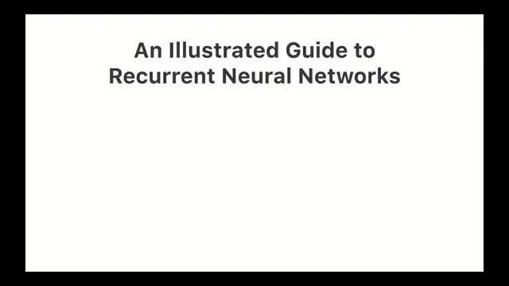

Slide 36


